Slide 1






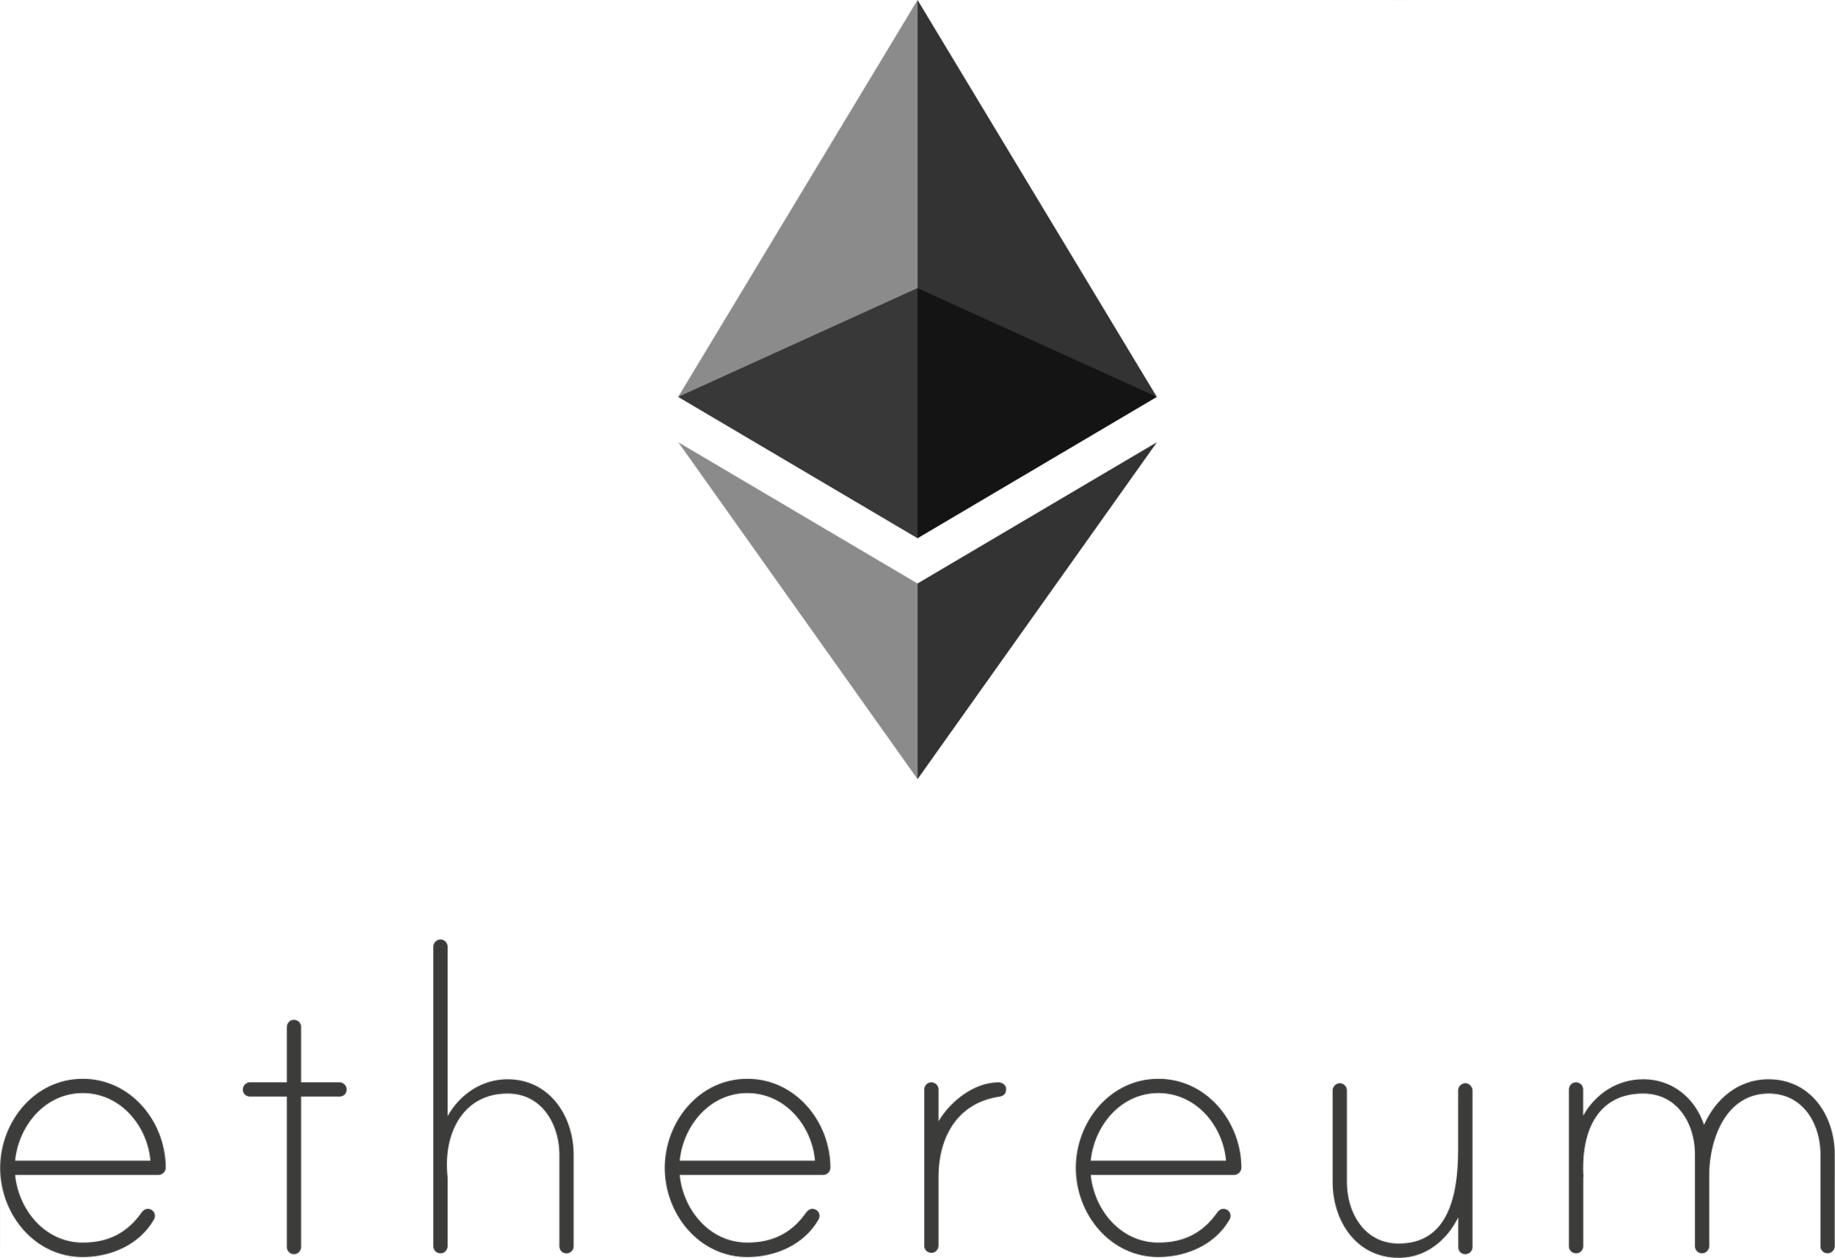





Epicenter Token At-A-Glance
1.
ECR is needed to unlock an EUSD credit line based on EPIC holdings
2.
ECR owners receive new assets as they are created: EDX, EON, EMPL, EYE, EFX, ECHO
3.
ECR features daily buyback & burn from fee income throughout the Epicenter ecosystem
4.
ECR is used in governance actions to determine the ongoing evolution of the protocols
Regulator Safe
NO ICO
NO PREMINE
NO VC’s
NO COMPANY
Available On:
Coming Soon
Community-Driven, Decentralized, Liberty-Oriented, Privacy-Preserving, Self-Sovereign, Supranatural, Transparent, Trust-Minimized

